Slide 1

SINGLE-PHASE TRANSFORMER
By Aditya Singh
2k19/a14/35

Slide 2
DEFINITION
The transformer is a static machine which transforms electrical energy from a certain voltage and current levels to another voltage and current levels keeping the frequency of the supply the same.
It is because the availability of the transformer that it is possible to generate energy from where it is available in abundance far away from the load centre and the energy so generated at economic voltage levels can be transmitted using transformers and the same energy can be utilized at economic and safe voltage levels as required by the devices using the electrical energy.

Slide 3
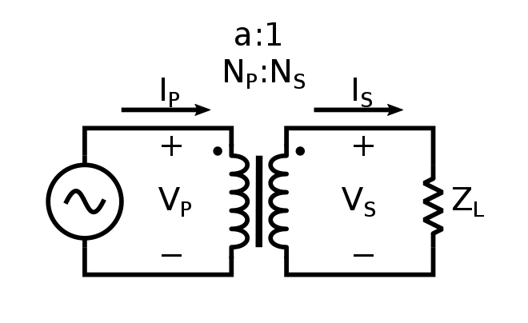
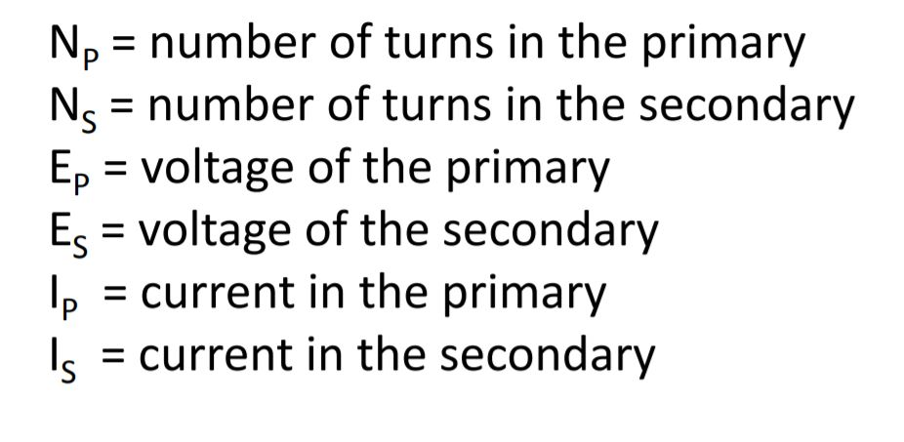
SYMBOLS

Slide 4
CLASSIFICATION
Based on Application
Step-Up (Ns>Np)
Step-Down (Np>Ns)
Based on Construction
Core Type
Shell Type

Slide 5
CONSTRUCTION
Core Type
Shell Type

Slide 6
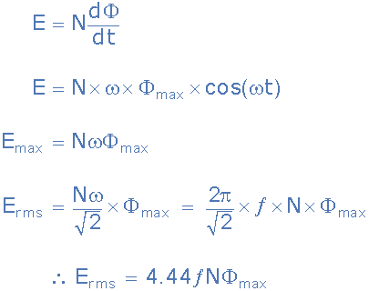
EMF EQUATION

Slide 7
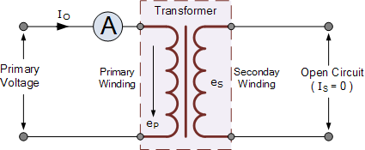
TRANFORMER ON “NO LOAD”
The ammeter will indicate a small current flowing through the primary winding even though the secondary circuit is open circuited. This no-load primary current is made up of the following two components :-
An in-phase current, I_{E} which supplies the core losses (eddy current and hysteresis).
A small current, I_{M} at 90º to the voltage which sets up the magnetic flux.

Slide 8
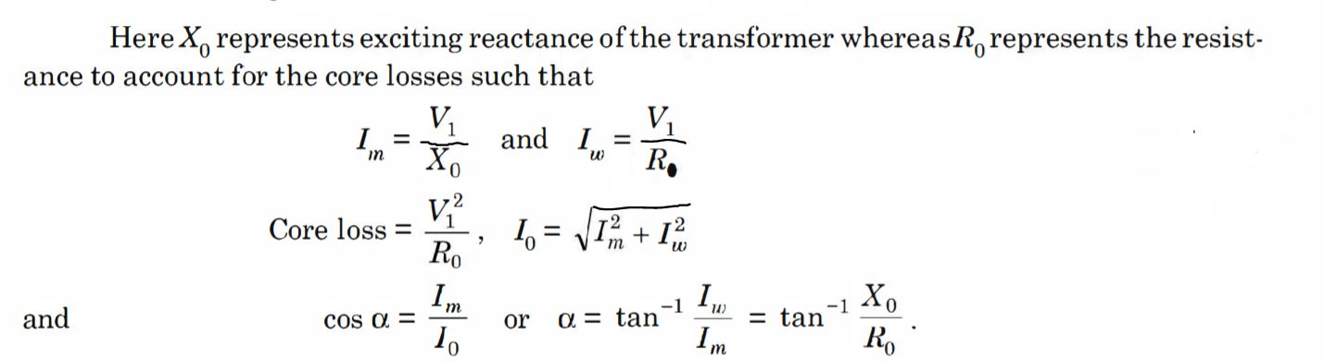
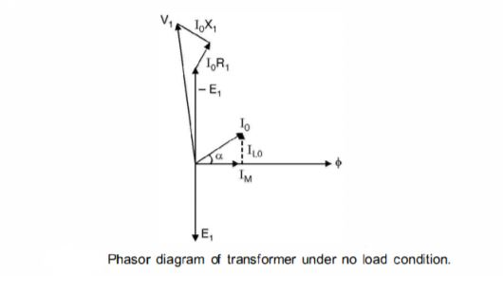
CORE LOSS UNDER NO LOAD

Slide 9

VOLTAGE REGULATION
The measure of how well a power transformer maintains constant secondary voltage over a range of load currents is called the transformer’s voltage regulation. It can be calculated from the following formula:
The measure of how well a power transformer maintains constant secondary voltage over a range of load currents is called the transformer’s voltage regulation. It can be calculated from the following formula:

Slide 10
LOSSES IN TRANSFORMER
Iron Losses
Hysteresis Loss
Eddy Current Loss
Copper Loss Or Ohmic Loss
Stray Loss
Dielectric Loss

Slide 11
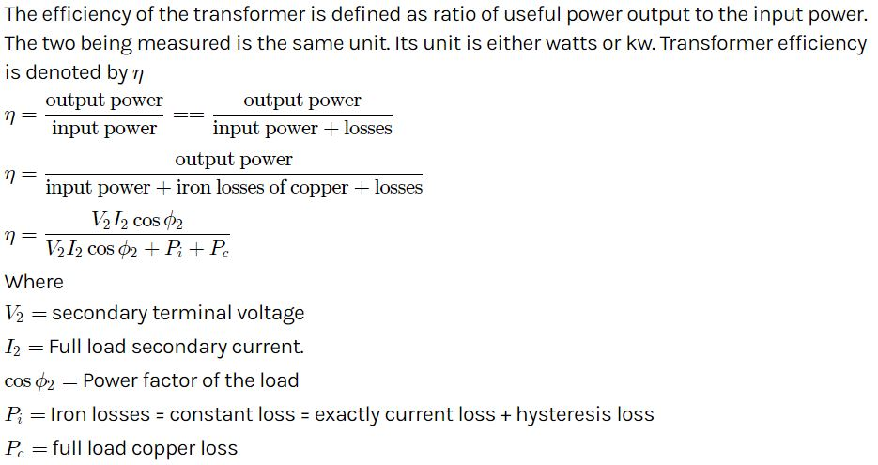
EFFICIENCY

Slide 12
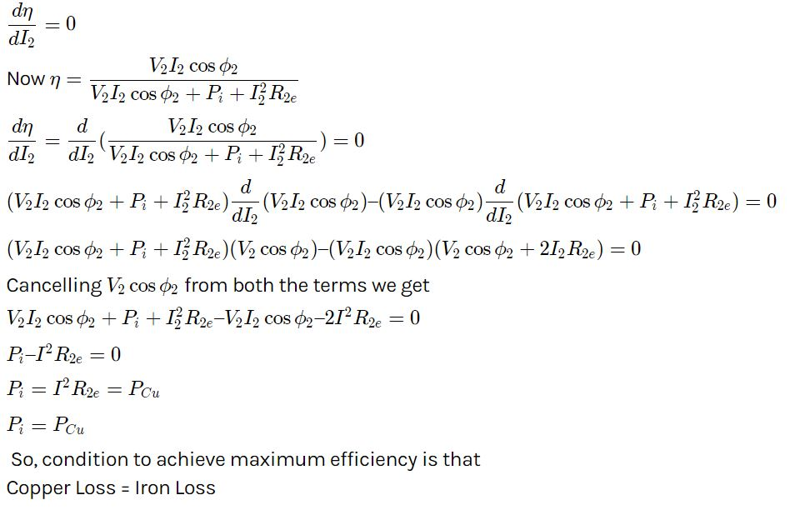
CONDITION FOR MAXIMUM

Slide 13
WHY TRANSFORMER ?
ADVANTAGES:
High efficiency.
Less capital and maintenance cost.
Continuous variable voltage.
Less Cu required.
Limitations
Power Ratings are low.
With frequencies below 10 to 20 Hz, the transformer size becomes unwieldy.

Slide 14
APPLICATIONS
Starting of induction and synchronous motors.
Used for Furnace Transformers
Used for testing and Learning in labs
Used in voltmeter, ammeters, protective relay etc.
To step up low voltage in case of measurement.
To step down high voltage for safety.
Used in rectifier, regulators, stabilizers, power supplies
Used in voltage regulators, voltage stabilizers, power supplies etc.

Slide 15
THANK YOU

